Slide 1
BAN 502 – Module 3 Introduction to Classification
Dr. Stephen E. Hill

Slide 2
What is Classification?
Titanic Passenger 1
Titanic Passenger 2
Male
55 Years Old
3rd Class Ticket
Female
8 Years Old
1st Class Ticket
Survived or Died?
Survived or Died?

Slide 3
What is Classification?
Potential Customer 1
Potential Customer 2
High Income
Previous Customer
Owns Luxury Car
Lower Income
Never a Customer
Owns Old, Used Car
Customer or Not?
Customer or Not?

Slide 4
Classification Problem
Predictive modeling problem with a categorical response (Y) variable
Response can have two categories (classes) → Binary classification OR
Multiple classes → Multinomial or Ordinal Classification

Slide 5
Classification Problem
Classification models will yield:
Predicted classes and/or
Probability of membership in a particular class

Slide 6
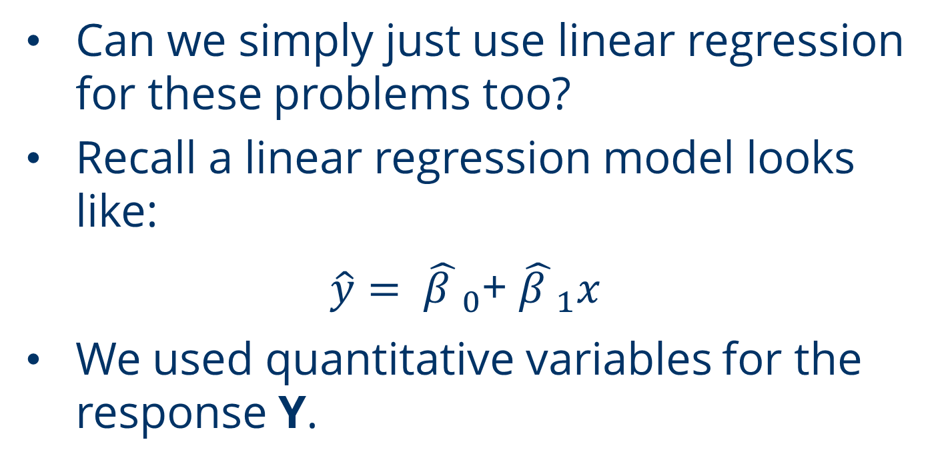
Linear Regression?
Can we simply just use linear regression for these problems too?
Recall a linear regression model looks like:
$\hat{y}= {\hat{β }}_{0}$+ ${\hat{β }}_{1}x$
We used quantitative variables for the response Y.

Slide 7
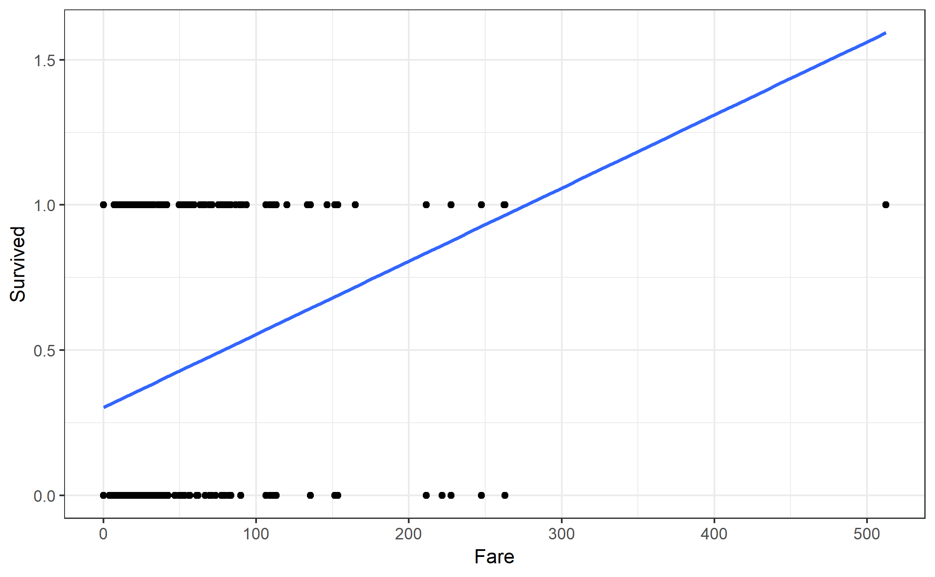
Linear Regression?

Slide 8
Classification Models
Logistic Regression → Linear model similar to linear regression
Classification Trees
Random Forests
Other Advanced Approaches

